Slide 1
Cyclistics Bike share Analysis
Author: Amzat Ridwan
Last updated : Jan 22nd 2022
Notes:
A case study analysis on Bike sharing system in Chicago
Comparison of Annual Member and Casual Riders Bike Usage in year 2021

Slide 2
AGENDA
Introduction​
Objectives
Findings
Recommendation
​Conclusions

Slide 3
Introduction
Cyclistic is a fictional company launched in 2016 to provide successful bike sharing system across Chicago.
Since then, the program has grown to a ﬂeet of 5,824 bicycles that are geo-tracked and locked into a network of 692 stations across Chicago. The bikes can be unlocked from one station and returned to any other station in the system anytime.

Slide 4
Objectives
Business Goal
The business objectives is to design a marketing strategy aimed at converting casual riders into Annual member rider

Slide 5
Objectives
Business Task
Is to analyze the dataset to helps in discovering :
how cyclistic riders use bike differently
Why would casual rider subscribe for the membership plan and
How to use digital media to influence casual riders to become a annual members

Slide 6
Findings
Number of Trips :
Over all number of rides distribution took by Riders in year 2021
Number of Rides Trends during the days
2. Trips Length:
Trips length longer than 24hrs
Trips length shorter than or equal to 24hrs
3. Route:
Top 10 route by used by casual riders
Top 10 route used by Annual members
4. Bike usage comparison:
Most least preferred bike type by user
Most preferred bike type by user

Slide 7
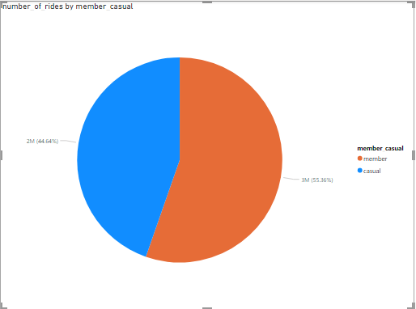
Findings
Total Rides distribution among Riders
Casual riders took 44.64 % of total rides
Member s took 56.36 % of total rides

Slide 8
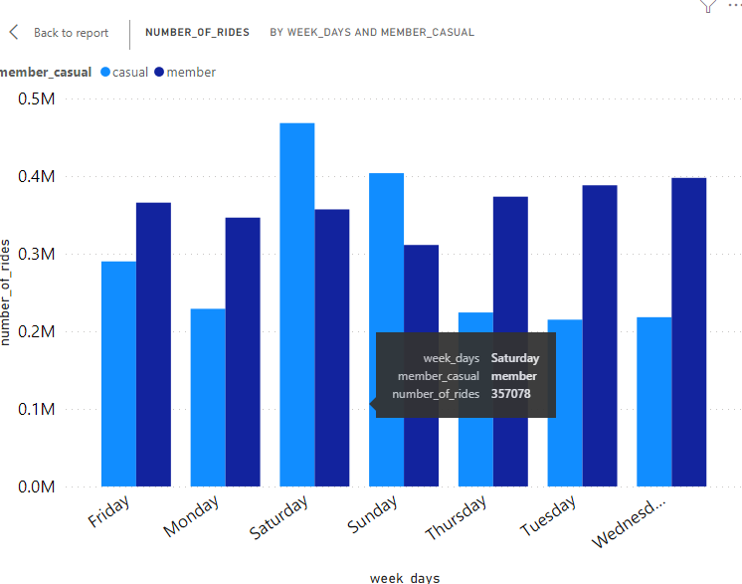
Findings
Number of rides trends over the days
Casual riders took bikes mostly on weekend with a
Peak on Saturday
Members took bikes mostly on workdays with a
Peak on Wednesday
Trips made by members are consistent during the
weekdays

Slide 9
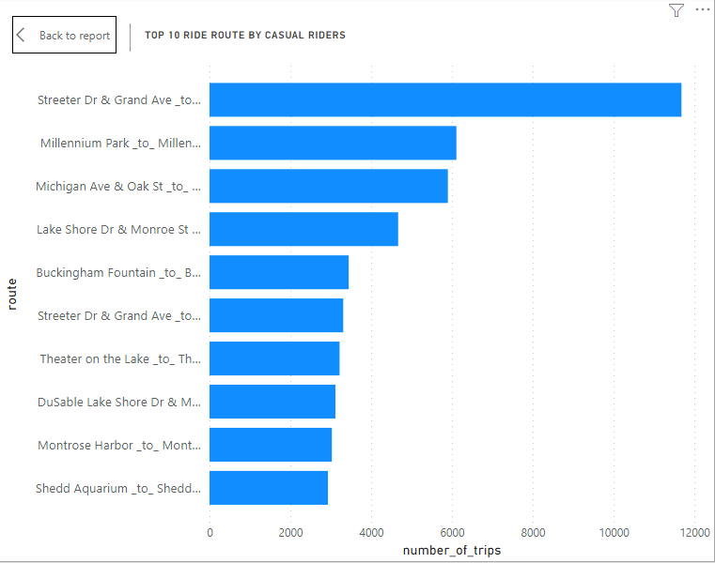
Findings
TOP 10 ROUTE USED BY CASUAL RIDERS
Key takeaways:
Streeter Dr & grand Ave to Streeter Dr & Grand Ave
Is the most popular route used by casual riders
Over 11k casual riders route around Streeter Dr & Grand Ave
to Streeter Dr & Grand Ave
Most of casual riders trips are returns trip i.e they return
Bike to their start station

Slide 10
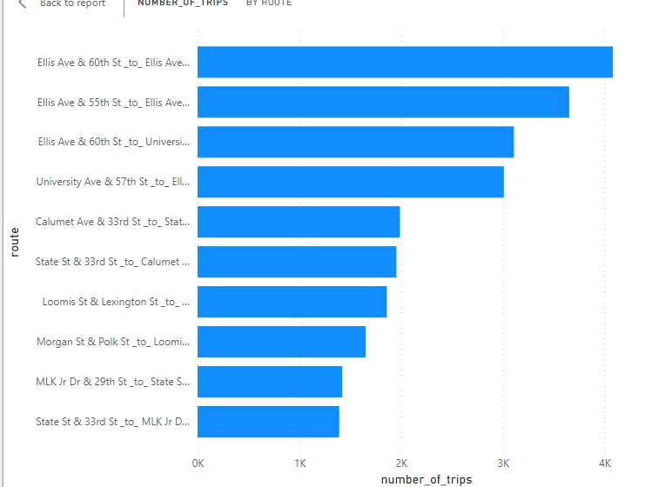
Findings
TOP 10 ROUTE USED BY ANNUAL MEMBER
Key takeaways:
Ellis Ave & 60th St to Ellis Ave & 55th St
Is the most popular route used by causal riders
Annual member make most trips but start station
and end station varies widely

Slide 11
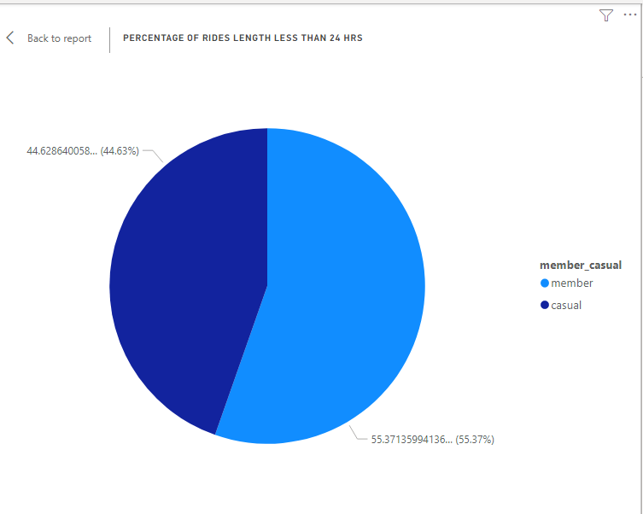
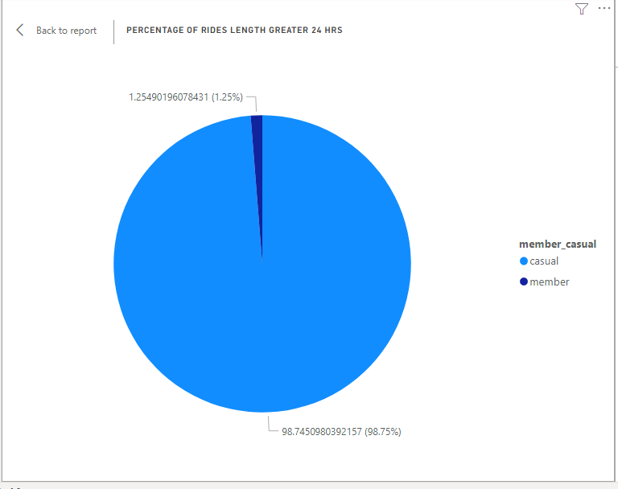
Ride length
24 hrs and less
Greater than 24 hrs
Annual Member mainly took rides in less than 24 hrs
Large percentage of Casual riders typically took rides greater than 24 hrs long

Slide 12

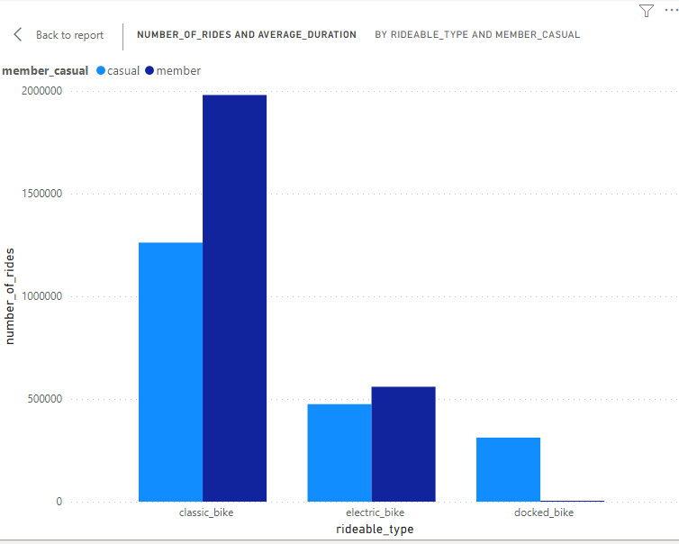
Findings
Bike Usage comparison by Riders type
Classic bike are mostly preferred by both Annual
Member and casual riders
Docked bike are the least preferred by both riders
Docked bike are mostly used by casual riders

Slide 13
Recommendation
TOP 3 RECOMMENDATION BASED ON FINDINGS
GIVING DISCOUNT TO ANNUAL MEMBER RIDES LONGER THAN 24HRS
Giving discount on trips length longer than 24hrs for Annual member will attract casual riders to subscribe for membership plan. since most of their trips duration are longer than 24hrs
BILL BOARD PLACEMENT
Placing bill board advert on the most widely used ROUTE by casual riders
Streeter Dr & grand Ave, Millennium Park and Michigan and oak St And
Displaying the benefit of subscribing to Membership plan on bill board
WEEKEND BONUS MAIL REMINDER
Sending mail notification to casual riders on weekend to stand a chance to win a weekend bonus when subscribing to their Annual membership plan

Slide 14
conclusion
All recommendations are made based on insight generated from analysis conducted
Additional data like user Riders’ data (eg. personal details, address) will facilitate more targeted marketing strategies
Personal detail will help to discover the typical age of a rider and How does it will influence bike usage
Rider usage data – asking the riders pertinent questions (eg, via survey) like
Why do they use the bikes? For work, leisure? might help in determining whether casual riders would be able to subscribe to membership plan
5. The Recommendation made may not work for Casual riders that came for tour since they are not living in Chicago

Slide 15
THANK YOU 😎😎😎
Any Question ?
Visit amzatr886@gmail.com

